Slide 1

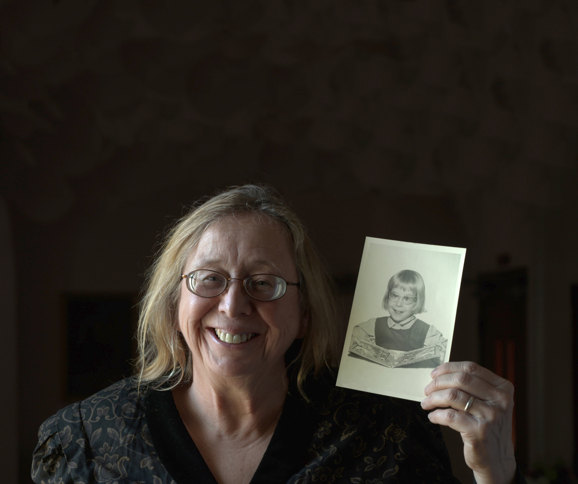

World Budget Offering
3 WAYS TO GIVE
OFFERING:
Mark your tithe envelope for
Christian Record on April 11
MAIL:
PO Box 6097, Lincoln, NE 68506
ONLINE:
ChristianRecord.org/give

